Slide 1


Jose Manuel Ruiz
09/06/2024

Slide 2
Outline
Executive Summary
Introduction
Methodology
Results
Conclusion
Appendix

Slide 3
Summary of methodologies
This projects attempts to identify the fac that involves in a successful rocket landing, the methodologies used to determine that where the following
Collect data using SpaceX REST API and web scraping techniques to extract Falcon 9 launch records from Wikipedia.
Wrangle data to determine the success and fail outcome variables of Stage 1.
Explore data visualization techniques using a database to determine what attributes are correlated with successful landings.
Data Analysis using graphs based on our findings and attributes correlated.
Explore launch sites success rates and proximity using geographical markers.
Visualize the launch sites success rates using interactive data visualization techniques.
Build ML models to predict the landing outcomes using Log Regression, SVM, Trees and KNN.
Summary of all results
The launch success has improved over time.
The payload Mass it’s a key factor to determine the success of a rocket launch.
The KSC LC-39A landing site has the highest success rate.
Orbit ES-L1, GEO, HEO and SSO have a 100% success rate.
Launches sites tend to be close to the coast but far from any civilization.
Executive Summary

Slide 4
Introduction
Project background and context
The commercial space industry is booming, and companies like Virgin Galactic, Rocket Lab, Blue Origin and SpaceX offers various space services. SpaceX is the most popular out of the space services providers. In particular, they have been providing relatively inexpensive rocket launches by reusing their first stage of their Falcon 9 rockets.
SpaceX launches have a cost of approximately $62 Million dollars each, compared to its competitors that offer the same service for $165 Million dollars each or even more. The ability to reuse the first stage is a key factor in SpaceX cost savings and popularity among its competitors.
Problems you want to find answers
Using the payload mass, launch site, num of flights, and orbits to determine the success of landing the first stage
Determine the cost of each launch of SpaceX based on whether the first stage is reused or not.
Develop ML models to predict if the first stage is going to be able to be reused for a given launch
Create visualization to show the findings found related to SpaceX launch costs.

Slide 5

Section 1

Slide 6

Methodology
Executive Summary
Data collection methodology: Using SpaceX REST API and Falcon 9 historical launch records.
Perform data wrangling by filtering data, handling missing values and applying one hot encoding.
Perform exploratory data analysis (EDA) using visualization and SQL
Perform interactive visual analytics using Folium and Plotly Dash
Perform predictive analysis using classification models to predict landing outcomes

Slide 7
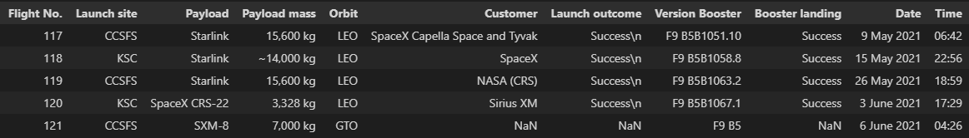
Data Collection
Datasets are collected from Rest SpaceX API and web scrapping from Falcon 9 launch records from Wikipedia
SpaceX API: https://api.spacexdata.com/v4/launches/past
Wikipedia:
https://en.wikipedia.org/w/index.php?title=List_of_Falcon_9_and_Falcon_Heavy_launches&oldid=1027686922

Slide 8
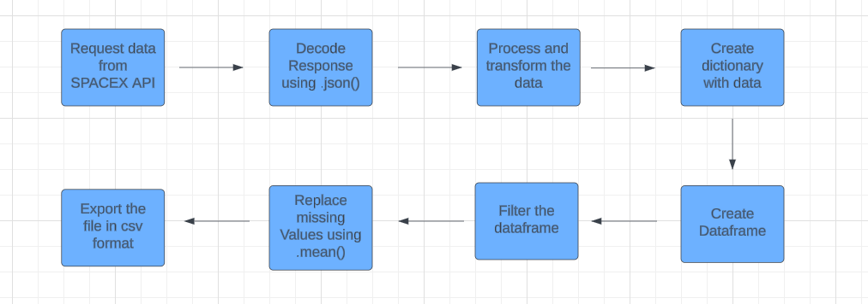
Data Collection – SpaceX API
Once we get the data from SpaceX API we place the data into a Pandas data frame.
Link to File: SpaceX API

Slide 9
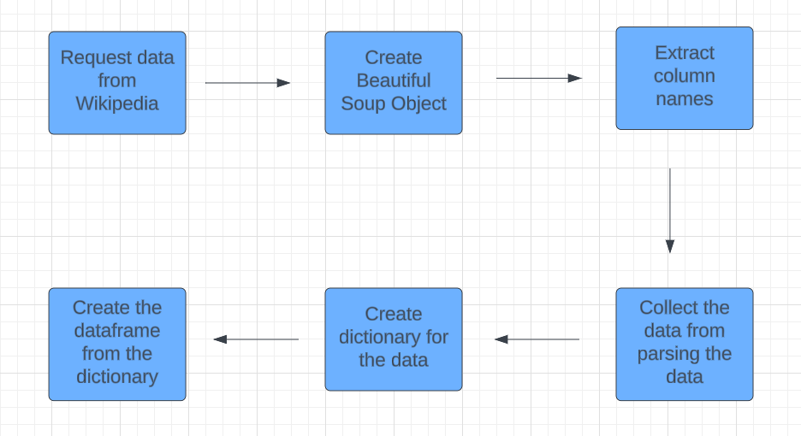
Data Collection - Scraping
Once we web scrape the data, we place it into a Pandas data frame
Link to File: Web scrapping

Slide 10
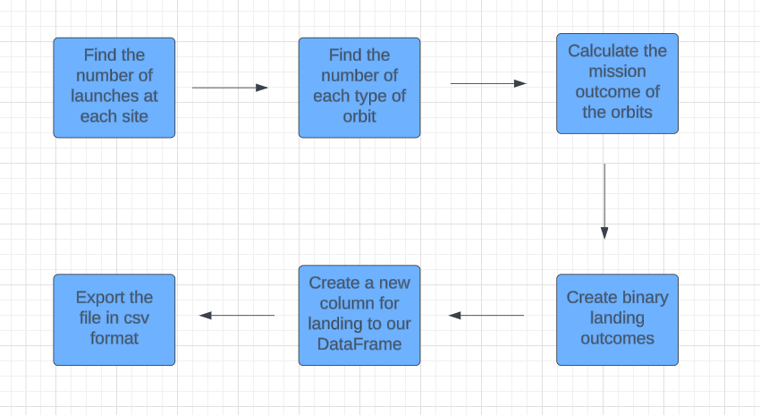
Data Wrangling
The new column determine the landing outcome, 0 is for an unsuccessful landing and 1 is for a successful landing.
Link to File: Data Wrangling

Slide 11
EDA with SQL
SQL queries
Names of unique launch sites
5 records where launch sites starts with “CCA”
Total played mass carried by boosters launched by Nasa (CRS)
Average Payload mass carried by booster version F9 v1.1
Date of the first successful landing
Names of booster which had a success in drone ship with payload mass in between 4000 and 6000 kg.
Total number of successful and failed missions
Names of booster version that carried the max payload mass
Failed landing outcomes on drone ship, booster version and launch site by months in 2015
Landing outcomes in between 2010-06-04 and 2017-03-20
Link to File: SQL

Slide 12
EDA with Data Visualization
By using scatter plots we can determine the variables that are useful to create ML algorithms. With bar and line graphs we can show comparisons with categorical variables
Scatter Plots
Flight Number vs Pay Load Mass (kg)
Flight Number vs Launch Site
Flight Number vs Orbit
Pay Load Mass (kg) vs Launch Site
Pay Load Mass (kg) vs Orbit
Bar Graphs
Success Rate vs Orbit
Line Graph
Success Rate vs Year
Link to File: Data Visualization

Slide 13
Build an Interactive Map with Folium
Markers indicating Launch Sites
Orange Circle to indicate the NASA Johnson Space Center’s coordinate
Red Circles for all launch sites coordinates with a popup label showing its name by using latitude and longitude coordinates
Colored markers of Launch Outcomes
Colored markers for successful (green) and unsuccessful (red) launches at each launch site to show the success rates
Distance between Launch site CCAFS SLC-40
Colored lines to show the distance between the nearest coastline, railway, highway and city
Link to File: Interactive Map

Slide 14
Build a Dashboard with Plotly Dash
Dropdown list with Launch Sites:
Allow user to select all launch sites or a certain launch site
Pie chart showing Successful Launches:
Allow user to see successful and unsuccessful launches as a %
Slider of Payload Mass Range:
Allow user to select the Payload Mass Range
Scatter chart:
Allow user to see the correlation between Payload and Launch Success
Link to File: Interactive Dashboard

Slide 15
Predictive Analysis (Classification)
Data preparation
Load dataset, normalize data, Split data into training and test sets.
Model Preparation
Selection of ML algorithms, Set parameter for each algorithm to GridSearchCV, Training GridSearchModel with training dataset.
Model Evaluation
Get best hyperparameters for each model, Compute accuracy for each model with test dataset, Plot the Confusion matrix.
Model Comparison
Compare among Logistic Regression, SVM, Tree and KNN algorithms according to their accuracy scores.
Result
The four algorithms performs equally, all of them return the same accuracy, Jaccard Score and F1 Score result.
Link to file: Classification model

Slide 16

Section 2

Slide 17
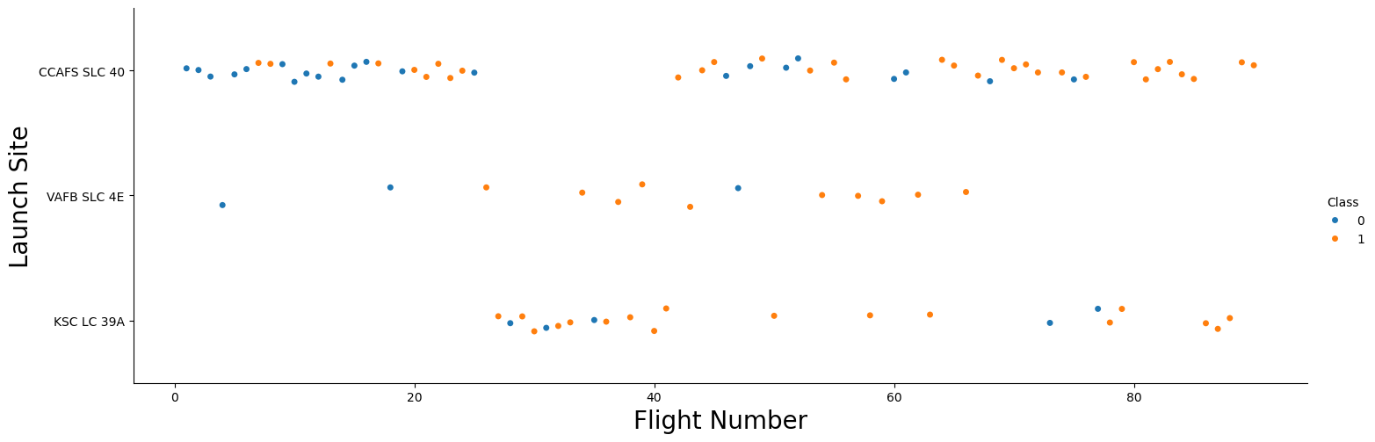
Flight Number vs. Launch Site
Earlier flights had a lower success rate (Blue) then later flights that had a higher success rate (Orange)
Around half of launches were from CCAFS SLC 40
We assume that new launches will have a higher success rate based on the amount of flight numbers

Slide 18
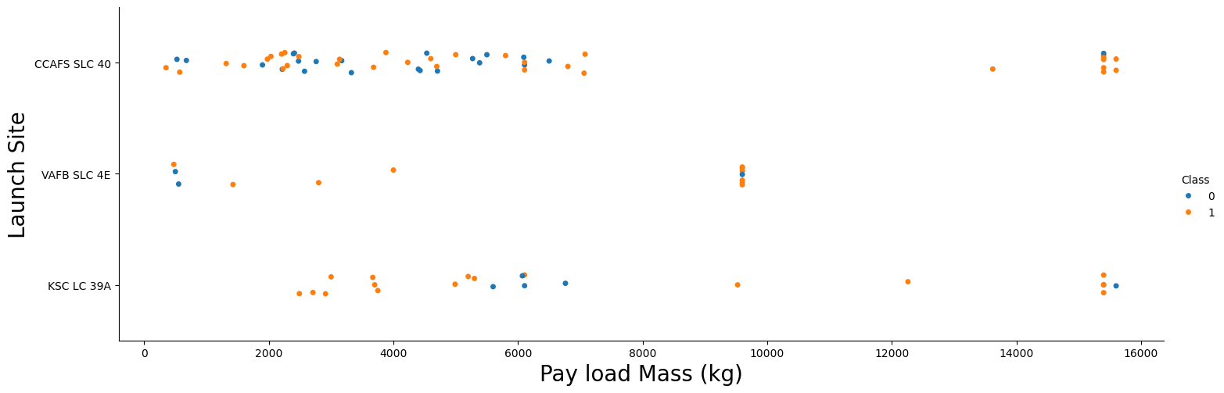
Payload vs. Launch Site
The higher the payload mass (kg), the higher the success rate
Launches with payload greater than 7,000 kg were mostly successful
KSC LC 39A has a 100% with launches with payload less than 5000 kg

Slide 19
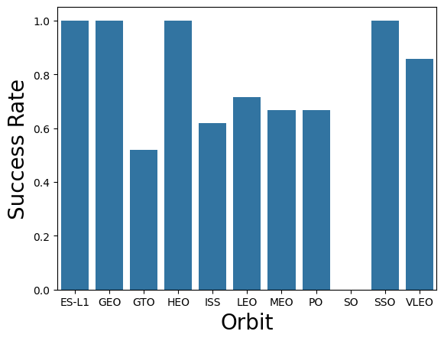
Success Rate vs. Orbit Type
Orbits ES-L1, GEO, HEO and SSO have a 100% success rate
Orbits GTO, ISS, LEO, MEO, PO and VLEO have a 50% to 85% success rate
Orbit SO has a 0% success rate

Slide 20
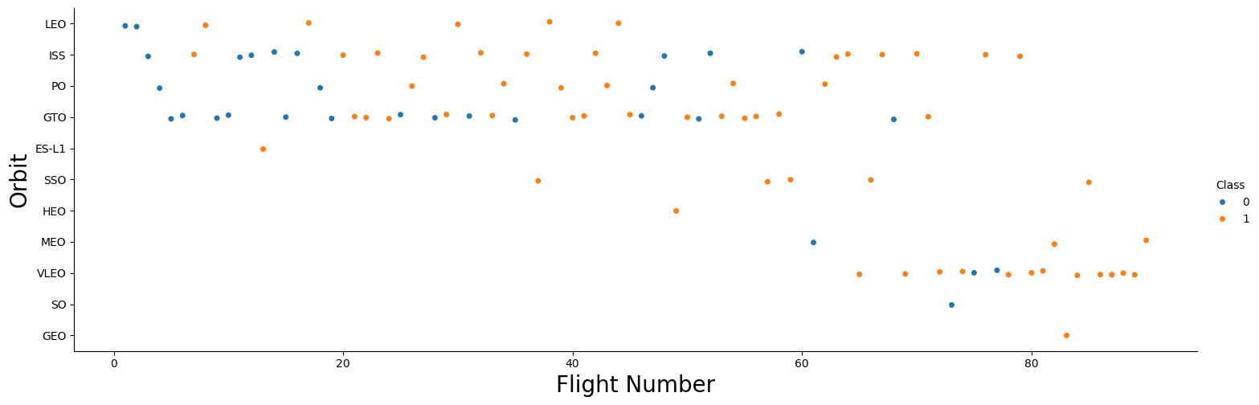
Flight Number vs. Orbit Type
The success rate increases with the number of flights for each orbit
The orbit GTO is the one that doesn’t look it follows this trend

Slide 21
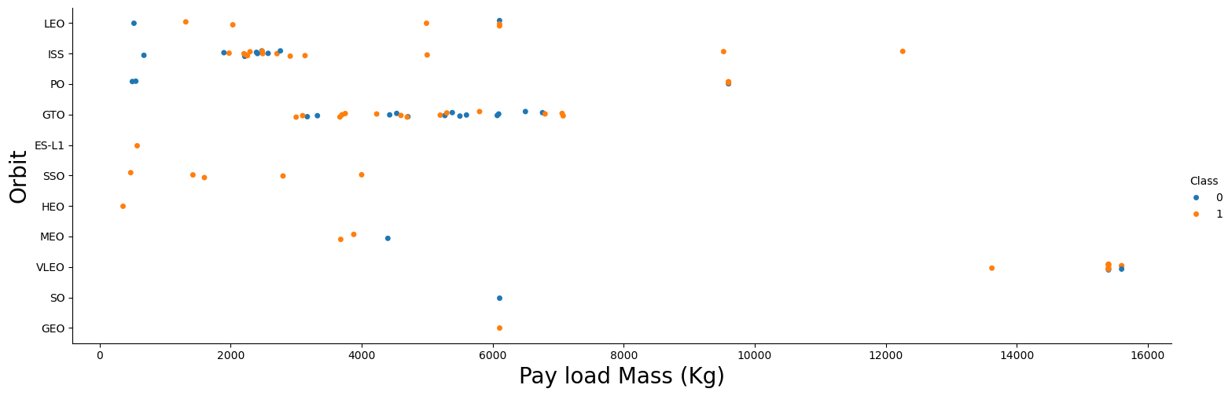
Payload vs. Orbit Type
Heavy Payload mass are better in LEO, ISS and PO orbits
We can’t assume there is a clear correlation with the orbits and Payload Mass

Slide 22
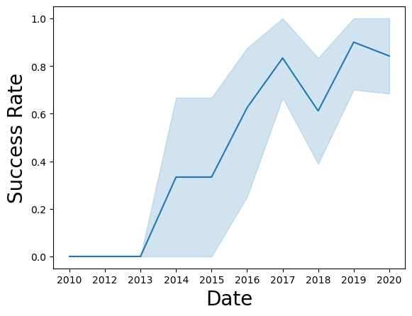
Launch Success Yearly Trend
The success rate improved from 2013-2017 and from 2018-2019
The success rate decreased from 2017-2018 and 2019-2020
The success rate has increased significantly over the years

Slide 23
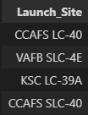
All Launch Site Names
Query:
%sql SELECT Distinct(LAUNCH_SITE) FROM SPACEXTBL;
There are 4 Unique launch sites

Slide 24
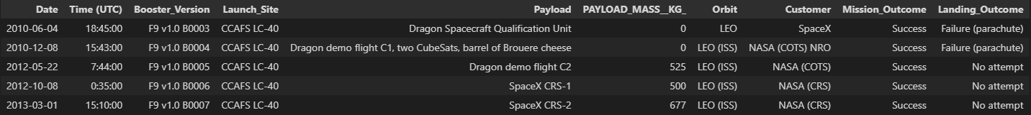
Launch Site Names Begin with 'CCA'
Query:
%sql SELECT * FROM SPACEXTBL WHERE LAUNCH_SITE LIKE "CCA%" LIMIT 5;

Slide 25
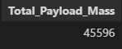
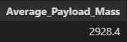
Total and Average Payload Mass
Total Payload Mass by boosters launched by NASA
Query:
%sql SELECT sum(PAYLOAD_MASS__KG_) AS Total_Payload_Mass FROM SPACEXTBL WHERE Customer = "NASA (CRS)";
Average Payload Mass carried by booster version F9 v1.1
Query:
%sql SELECT AVG(PAYLOAD_MASS__KG_) AS Average_Payload_Mass FROM SPACEXTBL WHERE Booster_Version = "F9 v1.1";

Slide 26
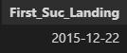
First Successful Ground Landing Date
Query:
%sql SELECT MIN(DATE) AS First_Suc_Landing FROM SPACEXTBL WHERE Landing_Outcome = "Success (ground pad)";

Slide 27
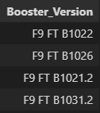
Successful Drone Ship Landing with Payload between 4000 and 6000
Query:
%sql SELECT BOOSTER_VERSION FROM SPACEXTBL WHERE PAYLOAD_MASS__KG_ BETWEEN 4000 AND 6000 AND LANDING_OUTCOME = "Success (drone ship)";
There are 4 booster version which have success in drone ship

Slide 28
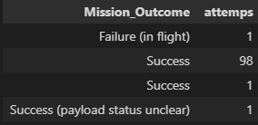
Total Number of Successful and Failure Mission Outcomes
Query:
%sql SELECT Mission_Outcome, COUNT(*) as attemps FROM SPACEXTBL GROUP BY Mission_Outcome;
There are 100 success mission with 1 of them having a payload status unclear.

Slide 29
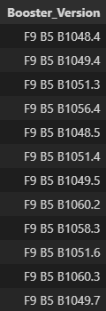
Boosters Carried Maximum Payload
Query:
%sql SELECT Booster_Version FROM SPACEXTBL WHERE PAYLOAD_MASS__KG_ = (SELECT MAX(PAYLOAD_MASS__KG_) FROM SPACEXTBL);

Slide 30
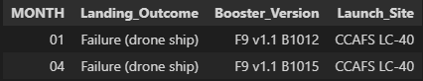
2015 Launch Records
Query:
%sql SELECT substr(Date, 6,2) AS MONTH, Landing_outcome, Booster_Version, LAUNCH_SITE FROM SPACEXTBL WHERE Landing_Outcome = "Failure (drone ship)" AND substr(Date, 0, 5) = '2015’;
This query shows failed outcomes, Booster version, Launch Site and the month of the landing in 2015.

Slide 31
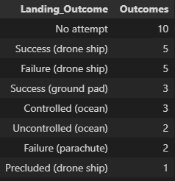
Rank Landing Outcomes Between 2010-06-04 and 2017-03-20
Query:
%sql SELECT Landing_outcome, count(*) AS Outcomes FROM SPACEXTBL WHERE DATE BETWEEN "2010-06-04" and "2017-03-20" GROUP BY Landing_outcome Order by Outcomes DESC;
Count of landing outcomes between 2010-06-04 and 2017-03-20, in descending order

Slide 32

Section 3

Slide 33
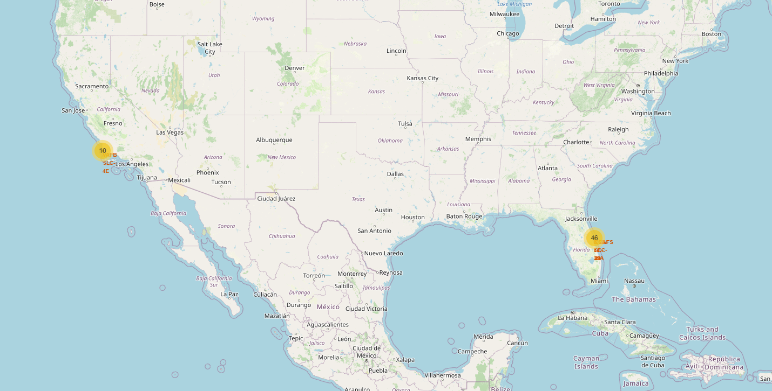
Launch Sites Locations
California, USA
VAFB SLC-4E
Florida, USA
KSC LC-39A
CCAFS LC-40
CCAFS SLC-40

Slide 34
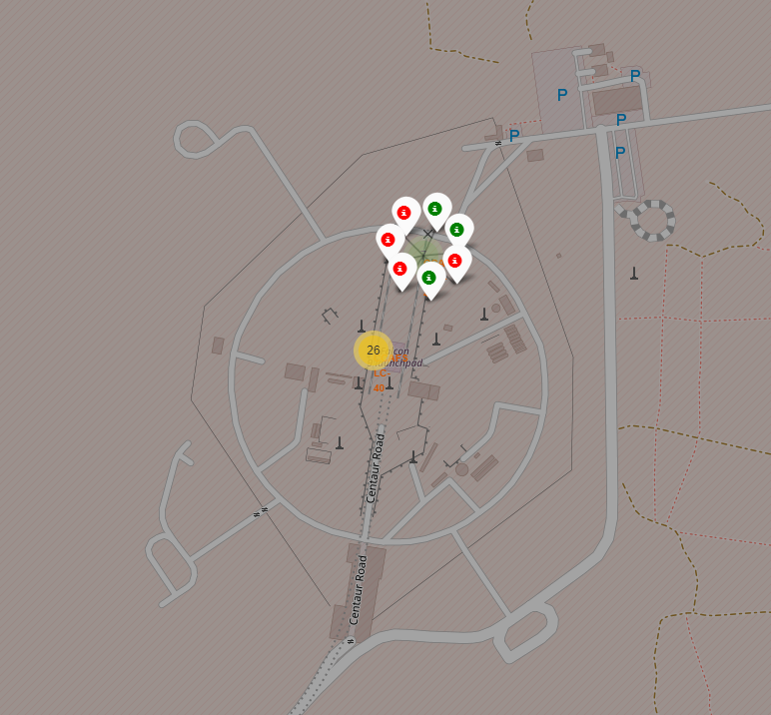
Launch Outcomes per launch site
At each launch site I add markers for each launch site.
Green markers for successful launches
Red markers for unsuccessful launches
The Launch Site CCAFS SLC-40 has a 3/7 success rate (42.9%).

Slide 35
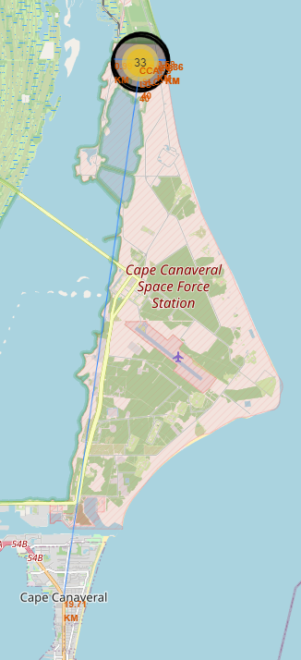
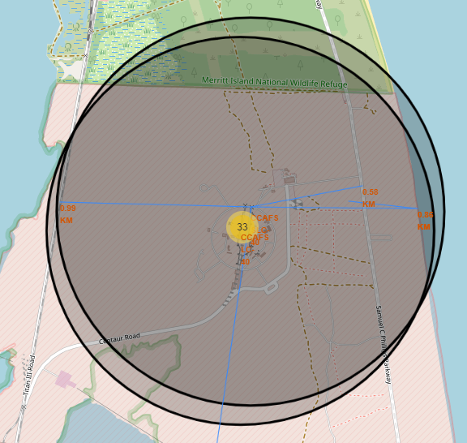
Distance to Proximities for CCAFS SLC-40
0.58 km for the nearest railway
0.86 km to the nearest coastline
0.99 km for the nearest roadway
19.71 km for the nearest city (Cape Canaveral)

Slide 36
Distance to Proximities for CCAFS SLC-40
Having Launch sites close to:
Coast: Helps ensure that failed launches don’t fall next to people or property
Transportation/Infrastructure: Helps bring workers, material and the necessary things to be able to launch rockets.
Safety: Needs to be an exclusion zone around the launch sites to keep unauthorized people away and to keep people safe from unsuccessful landing

Slide 37

Section 4

Slide 38
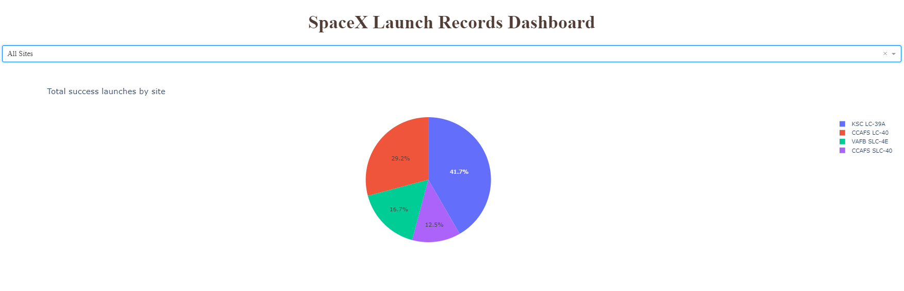
Launch Success by Site
The dropdown menu allows the user to select one or all launch sites
The pie chart displays the distribution of Successful Launches by sites
The KSC LC-39A has the highest success launches amongst launch sites (41.2%)

Slide 39
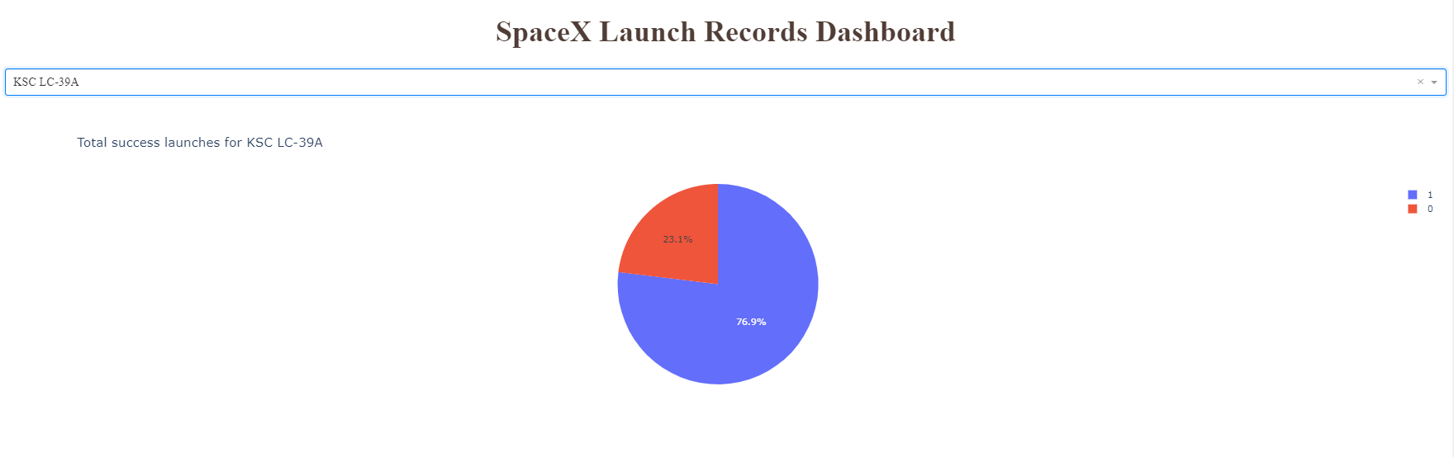
Launch Site KSC LC-39A
The pie chart is represented by 2 colors, the blue part (1) represents the successful landings and the red part (0) represent the unsuccessful landings. KSC LC-39A had a 76.9% of successful landing rate

Slide 40
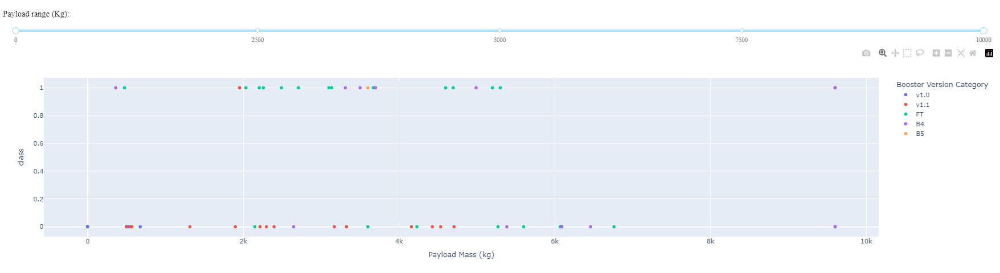
Payload vs Launch Outcomes
The scatter plot represent the Launch Outcomes vs Payload using a range slider, the points are by colors, each of them represent a Booster version category.
The “FT” booster version category has the largest success rate.

Slide 41
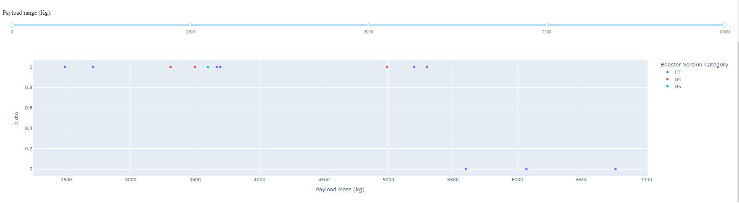
Payload vs Launch Outcome for KSC LC-39A
The KSC LC-39A has 10 successful landings and 3 unsuccessful landings and the scatter plot indicates that with less Payload Mass the success rate increases for this site.

Slide 42

Section 5

Slide 43
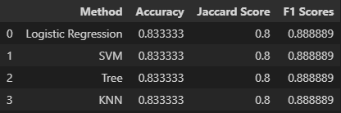
Classification Accuracy
The four algorithms performs equally, all of them return the same accuracy, Jaccard Score and F1 Score result
This is likely due to the small dataset used for testing.

Slide 44

Confusion Matrix
The confusion matrix summarizes the performance of each algorithm, since we have the exact same accuracy, the confusion matrices plotted for each algorithm were the same.
Outputs
12 true positives
3 true negatives
3 False positive
0 False Negatives

Slide 45
Conclusions
Payload Mass: Across all launch sites, the higher the payload mass, the higher the success rate.
Orbits: ES-L1, GEO, HEO, SSO have a 100% success rate.
Launch Success: It will increase over time as we test more launches.
Model Performance: The ML models have similar accuracy result, indicating that they’ll performed similarly.
Launch Sites: They need to be close to roads to facilitate access, but they need to be retired from any city to avoid possible risks.
A larger dataset will help build more on the predictive analytics result to help understand if the findings can be generalizable to a larger dataset.

Slide 46
Appendix
Datasets used:
SpaceX API: https://api.spacexdata.com/v4/launches/past
Falcon 9 records: https://en.wikipedia.org/w/index.php?title=List_of_Falcon_9_and_Falcon_Heavy_launches&oldid=1027686922
Github URL:
Data Collection: https://github.com/Josema321/IBM-Data-Science-Capstone_SpaceX/blob/main/data-collection-api_%20PT.1.ipynb
Web Scraping: https://github.com/Josema321/IBM-Data-Science-Capstone_SpaceX/blob/main/webscraping_PT.2.ipynb
Data Wrangling: https://github.com/Josema321/IBM-Data-Science-Capstone_SpaceX/blob/main/Data%20wrangling_PT.3.ipynb
SQL: https://github.com/Josema321/IBM-Data-Science-Capstone_SpaceX/blob/main/Sql_PT.4.ipynb
Data Visualization: https://github.com/Josema321/IBM-Data-Science-Capstone_SpaceX/blob/main/Exploratory_Analysis_Graphs_PT.5.ipynb
Interactive Map: https://github.com/Josema321/IBM-Data-Science-Capstone_SpaceX/blob/main/launch_site_location%20with%20Folium_PT.6.ipynb
Interactive Dashboard: https://github.com/Josema321/IBM-Data-Science-Capstone_SpaceX/blob/main/spacex_dash_app_PT.7.py
Classification Model: https://github.com/Josema321/IBM-Data-Science-Capstone_SpaceX/blob/main/SpaceX_ML_Prediction_Pt.8.ipynb

Slide 47


